Slide 1



KaggleX- Showcase Template
Notes:
Recommending picking out he most interesting and important parts from your documentation.

Slide 2
NLP EDA and Data Processing
Vincent Muiruri

Slide 3
Background
I am a junior data analyst with a background in Applied Mathematics having graduated in 2021 April.
I am currently working as risk advisory analyst in a consulting firm.
I am curious about data science and artificial intelligence.

Slide 4
Project Definition
I am curious about NLP, and therefore, I decided to do a project in the domain.
To begin with, I collected a dataset from Kaggle called Movie_Review which is common for sentiment analysis.
The objective is to identify topics/ words/ phrases that constitute a good movie.
Research question:
Learning Outcome: I am got to learn python programming, understand the concept of data science and how natural language processing works.
Therefore, I am better place to perform my main project next year.
My main project idea is: sentiment analysis on loan products among young people in Kenya.

Slide 5
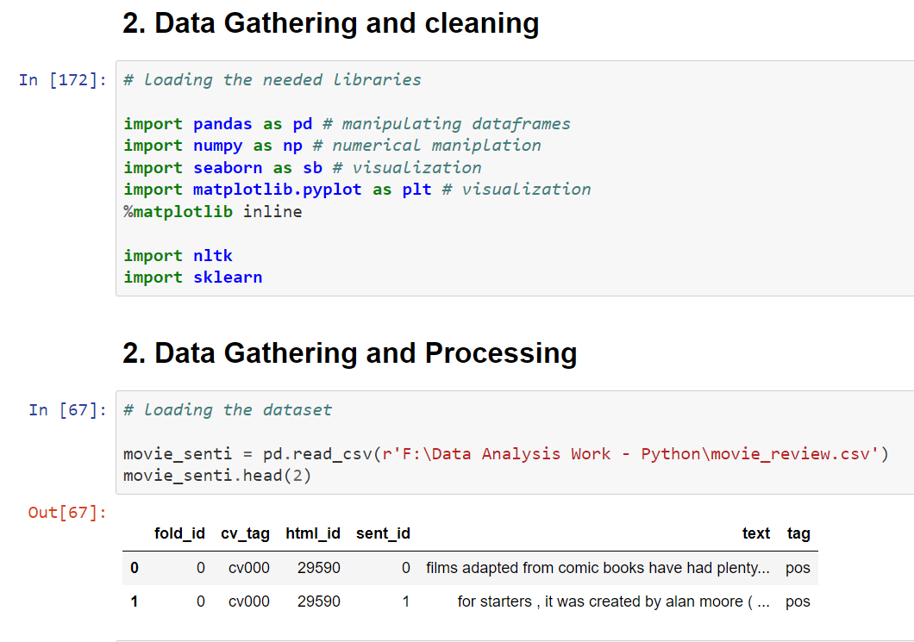
Importing Libraries and Python Packages

Slide 6
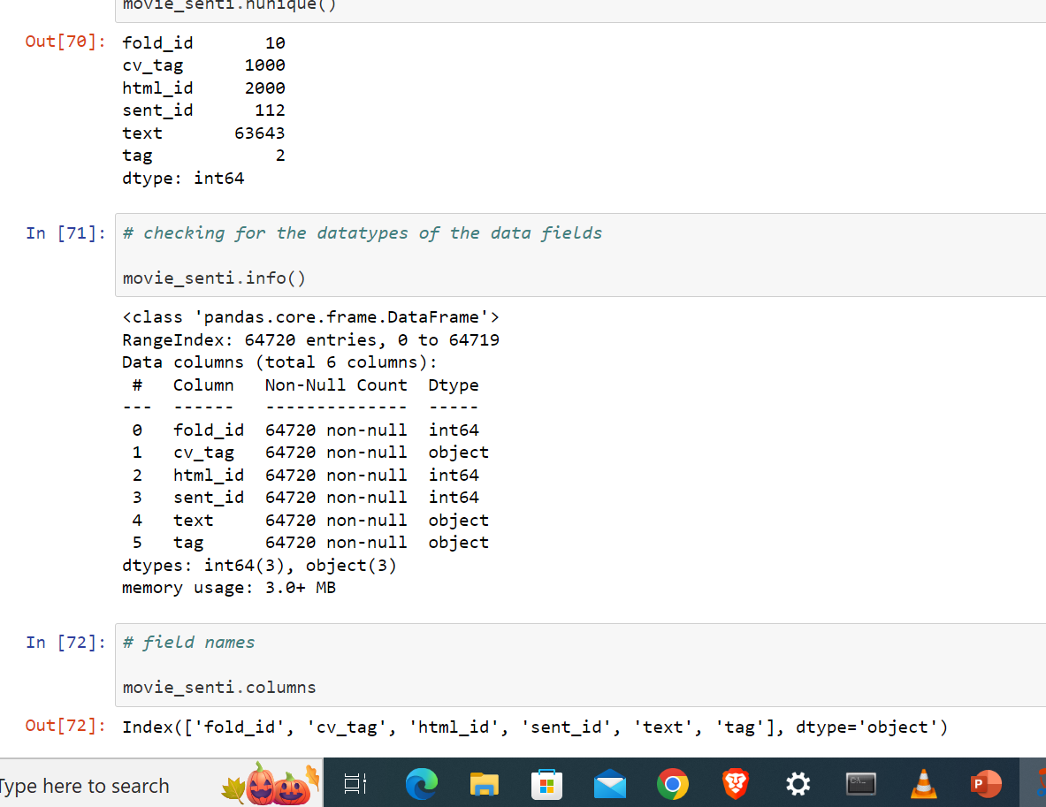
Data Processing

Slide 7
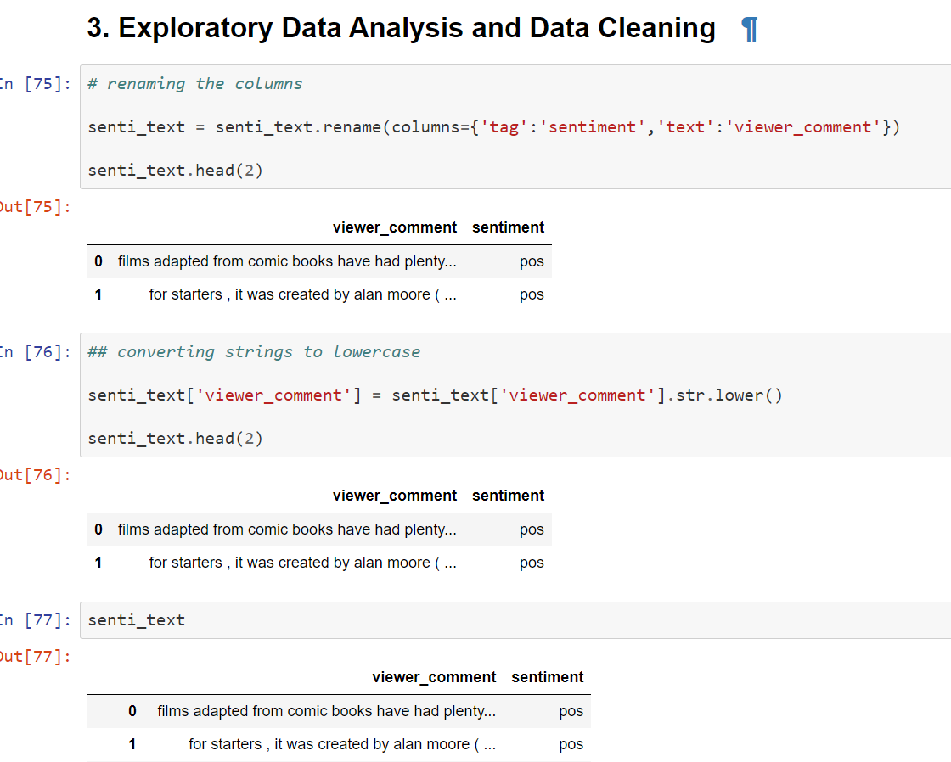
Data Cleaning: renaming column headers and putting lowercase

Slide 8
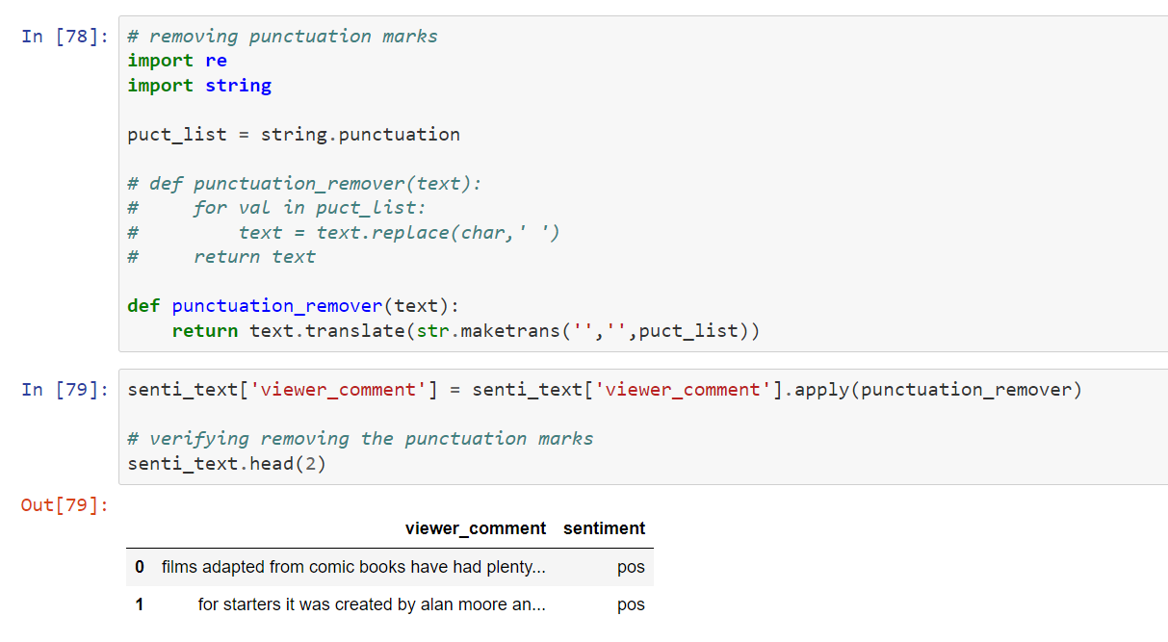
Data Cleaning: removing punctuation marks

Slide 9
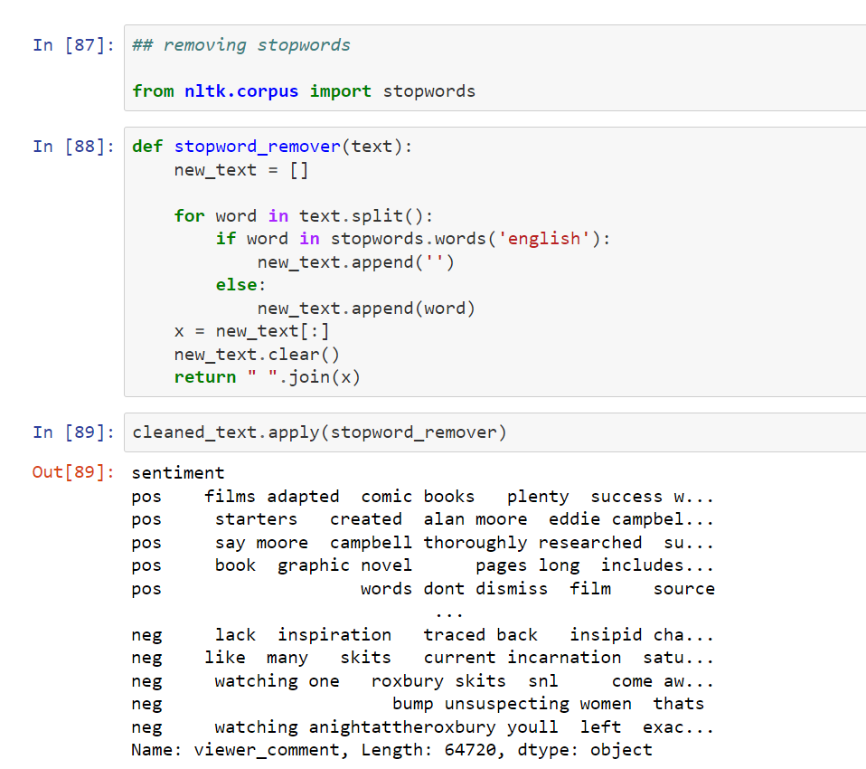
Data Cleaning: removing stopwords

Slide 10
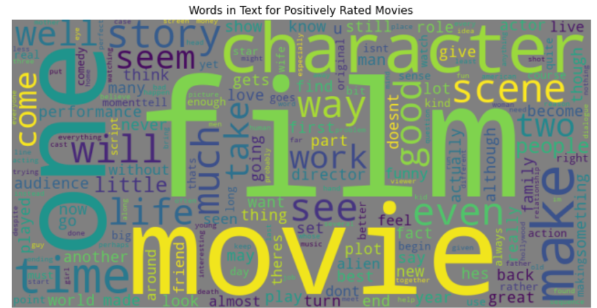
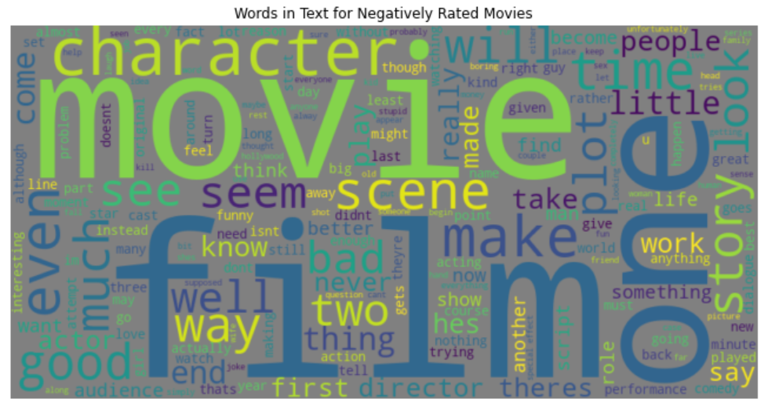
EDA: visualize word cloud of sentiments

Slide 11
Findings and next steps
Findings
For positively rated movies, the words character, story, and scene are clearly visible.
For the negatively rated movies, the words plot, time, and character are also visible.
Next Steps:
- Sentiment Analysis
- Topic Modelling
- Text Generation

Slide 12
Project Links
LinkedIn: https://www.linkedin.com/in/muiruri-vincent-84336b170/
Github: https://github.com/vincentmuiruri

